Slide 1
Deep Learning
Raheel Ahmad
June 26th, 2019
"Revue" of Models for Statistical Inference & Machine Learning

Slide 2
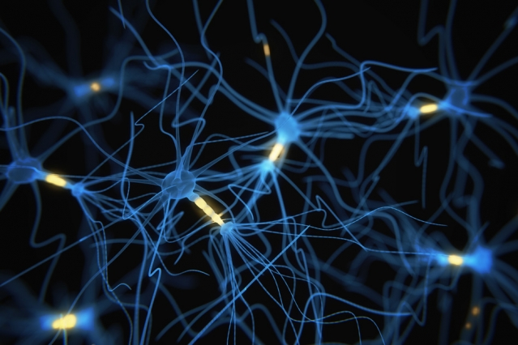
Neural Networks
Identify non-linear patterns in data that can predict an outcome
Model complex problems such as image processing and speech recognition
Adoption has been slow in genomics

Slide 3
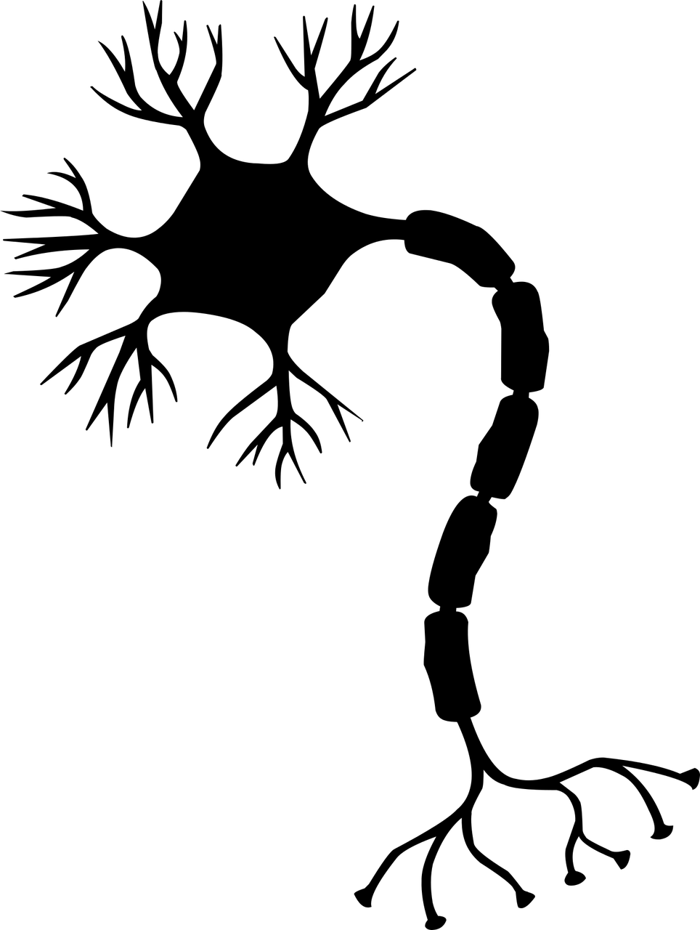
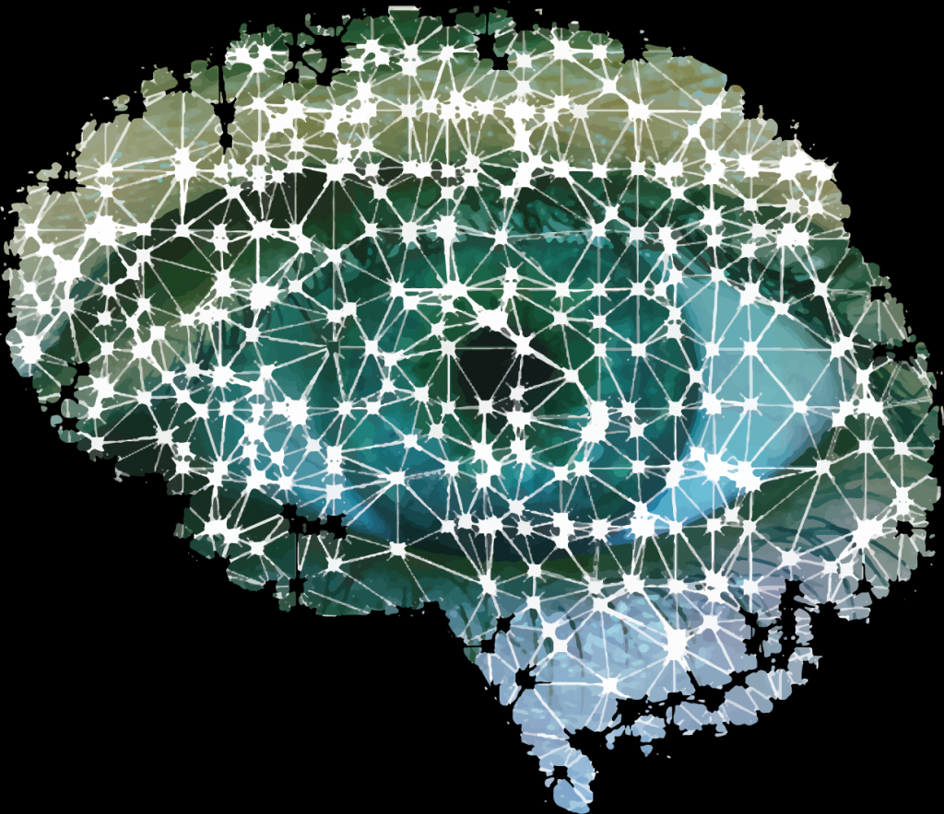

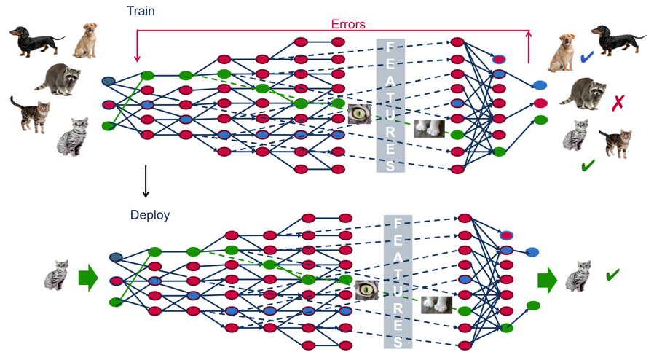
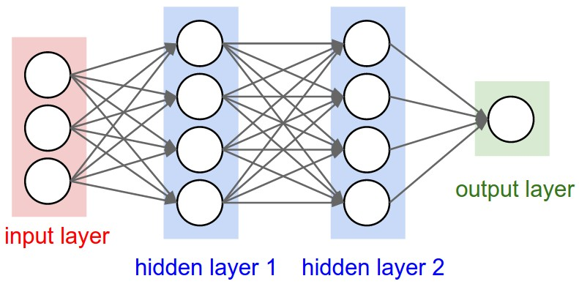
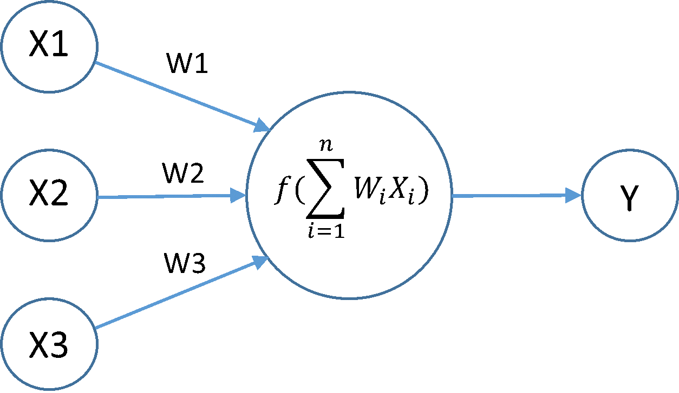



Deep Learning
Neuron → Network → Learning
CD11b+
Nope…
CD14+
CD16+
Mom, is that a dog?
Mature Monocyte
Neuron
Learning
Network

Slide 4
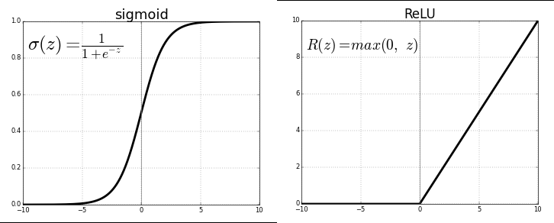
Why are NN’s Nonlinear?
Activation Functions
Multiple layers of nonlinear activation

Slide 5
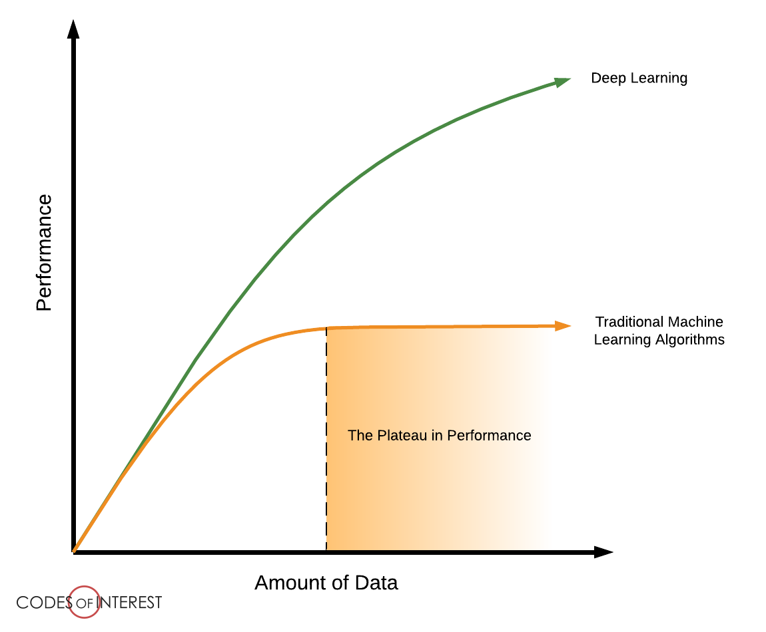
Use Cases
Large Datasets
?

Slide 6
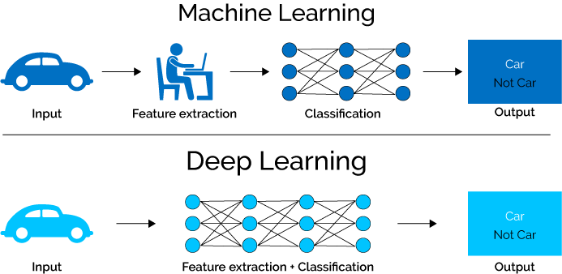
Use Cases
Feature Identification Difficult
Expert

Slide 7
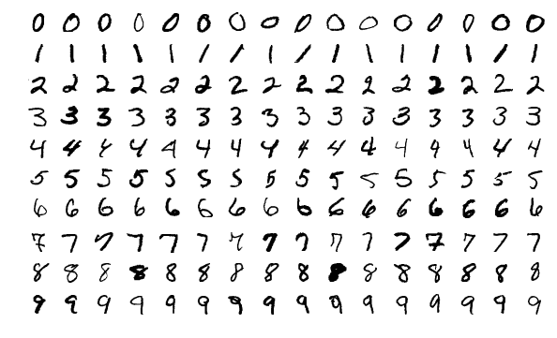
MNIST Dataset
Database of Handwritten Digits
60,000 examples
10,000 example test set
One

Slide 8
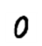
MNIST Data
Observations
Outcome
28 px
Zero
One
Two
.
.
.
Nine
28 px

Slide 9
Limitations
Requires large amounts of data
Computationally expensive
Difficult to comprehend learned patterns/features
Hyperparameter Tuning is an Art

Slide 10
Advantages
Easy to adapt to new problems
Less feature engineering
Outperforms many other algorithms in domain
Learning can be easily transferred to other datasets

Slide 11
Common Deep Learning Architectures
Multilayer Perceptron - MNIST Example
Convolutional NN – Image Classification
Recurrent NN – Sequence Data

Slide 13
Optimizer

